Slide 1
Tracking Oregon’s Wildlife
J. Mark Daniels, PhD Flatiron School
Data Scientist Washington DC

Slide 2
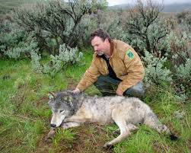
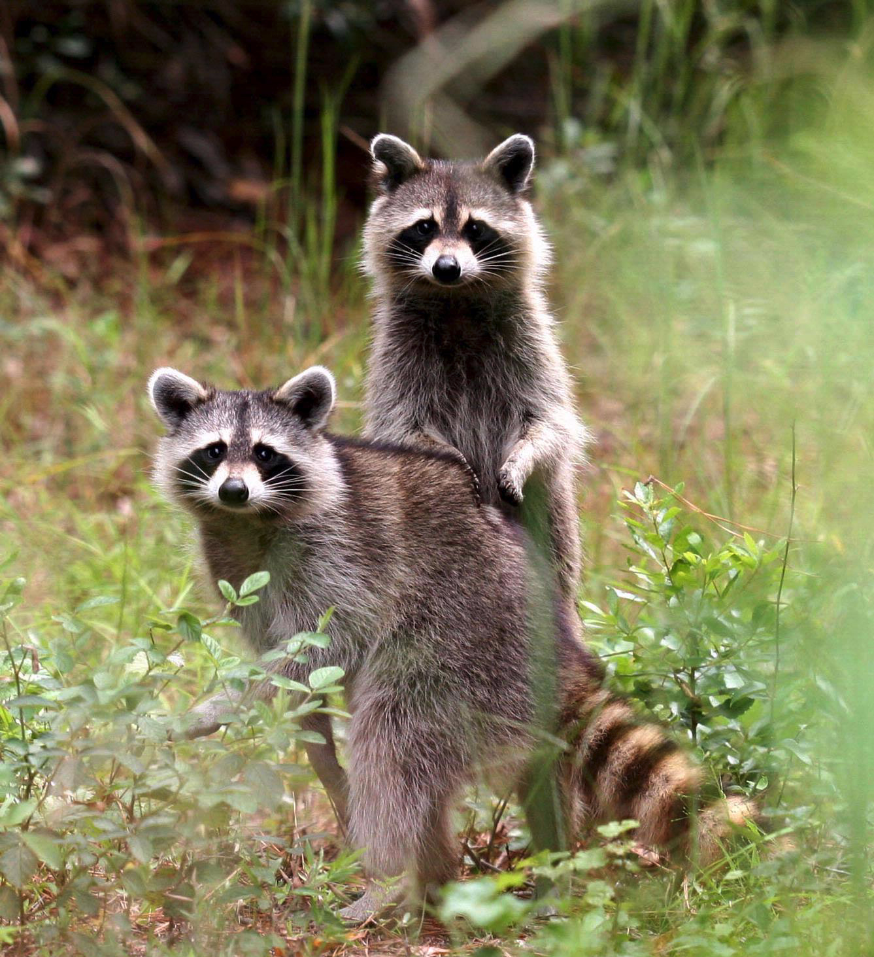
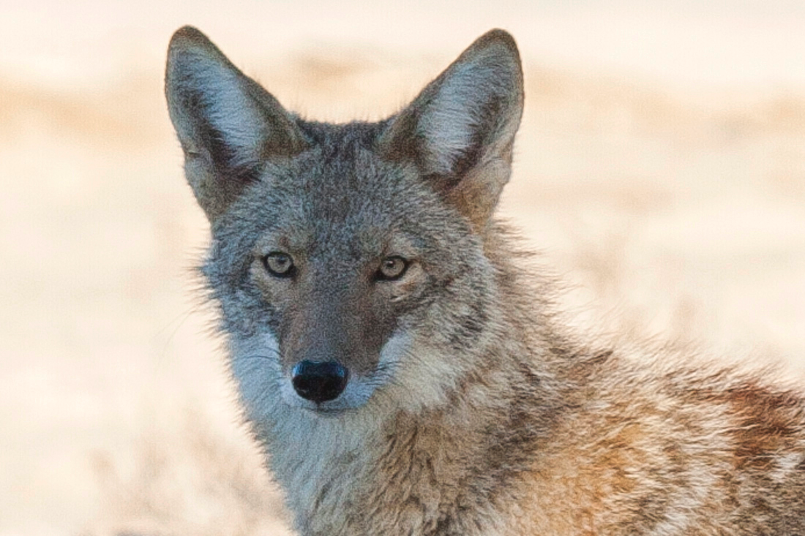
Target Audiences
01 | State of Oregon
02 | Department of Fish and Wildlife
03 | Conservation Groups
04 | Wildlife Biologists
Image Credit

Slide 3
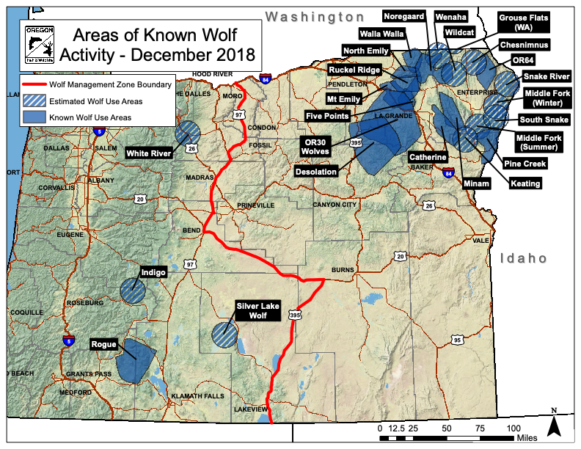
Oregon Fish and Wildlife tracks the wolf population
Why?
Image Credit
Notes:
Discussion point - agriculture conflicts, hunting permits, safety advisories, conservation

Slide 4
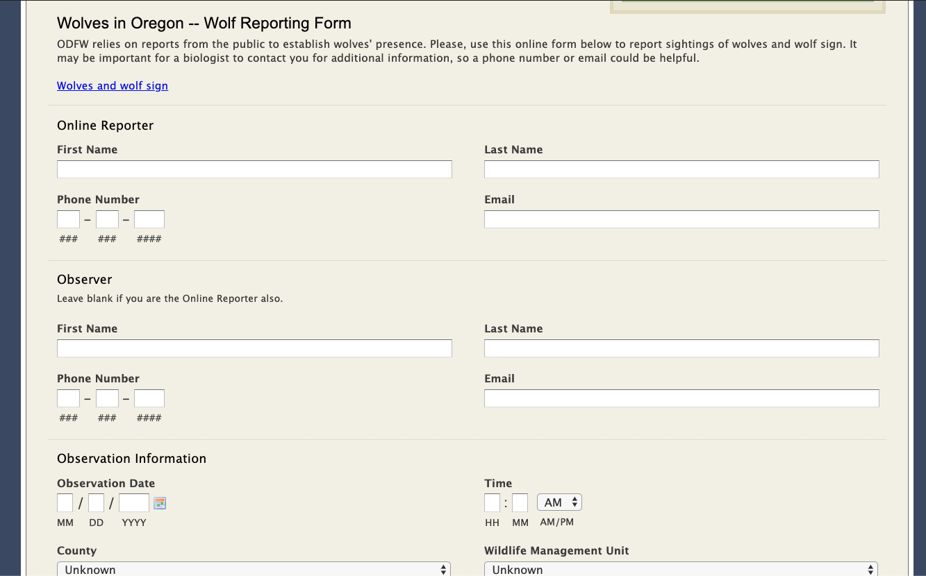
The current reporting form
A bit archaic and cumbersome
Image Credit

Slide 5
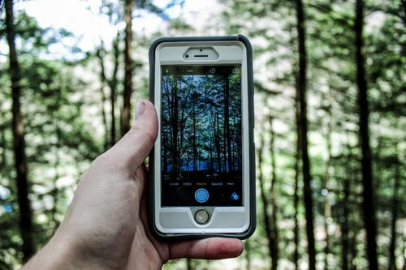
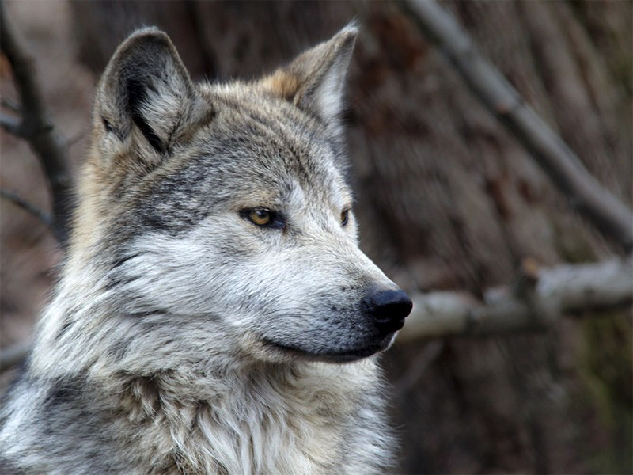
What if it was easier?
Image Credit

Slide 6
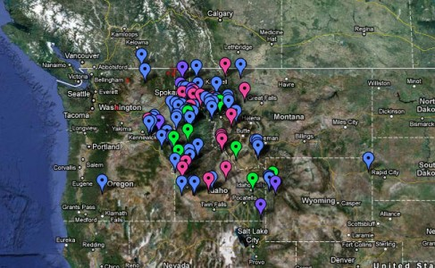
Simplify reporting:
Image Credit
Track sightings of species of interest (endangered, invasive, and/or nuisance).
Extract image geotags to plot and track animal locations.
Incorporate citizen scientists similar to the Backyard Bird Count
Track migration and distribution patterns.

Slide 7
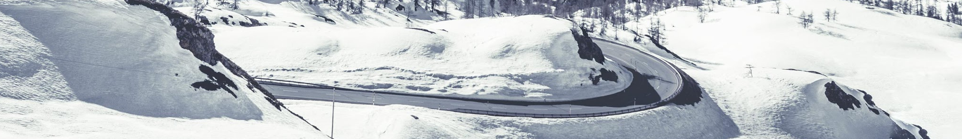
Built image classification to identify wildlife
Kaggle Dataset - 14,013 images in 20 classes
Created binary and multiclass image classification systems
Binary (88% accuracy) for tracking of specific species of interest
Multiclass (75% accuracy) for general classifications

Slide 8
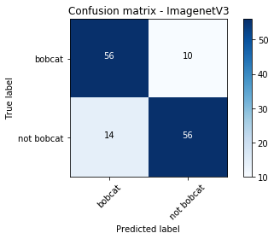
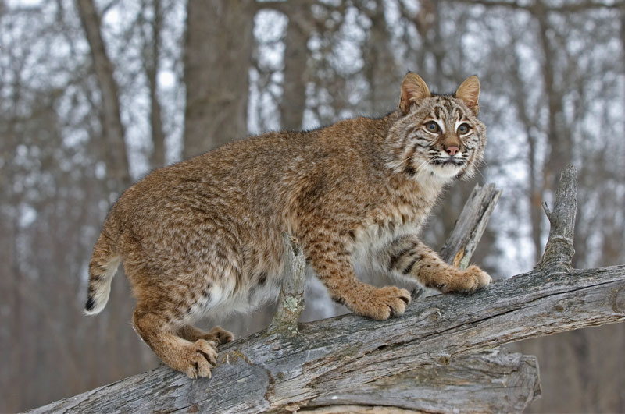
Binary Model Performance
Binary (Single Species) Classification:
88% Accuracy
82% F1

Slide 9
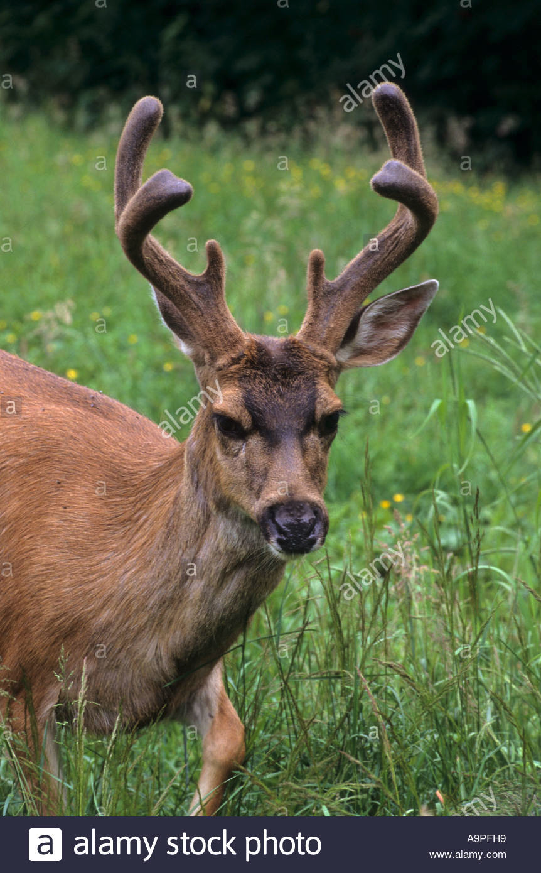
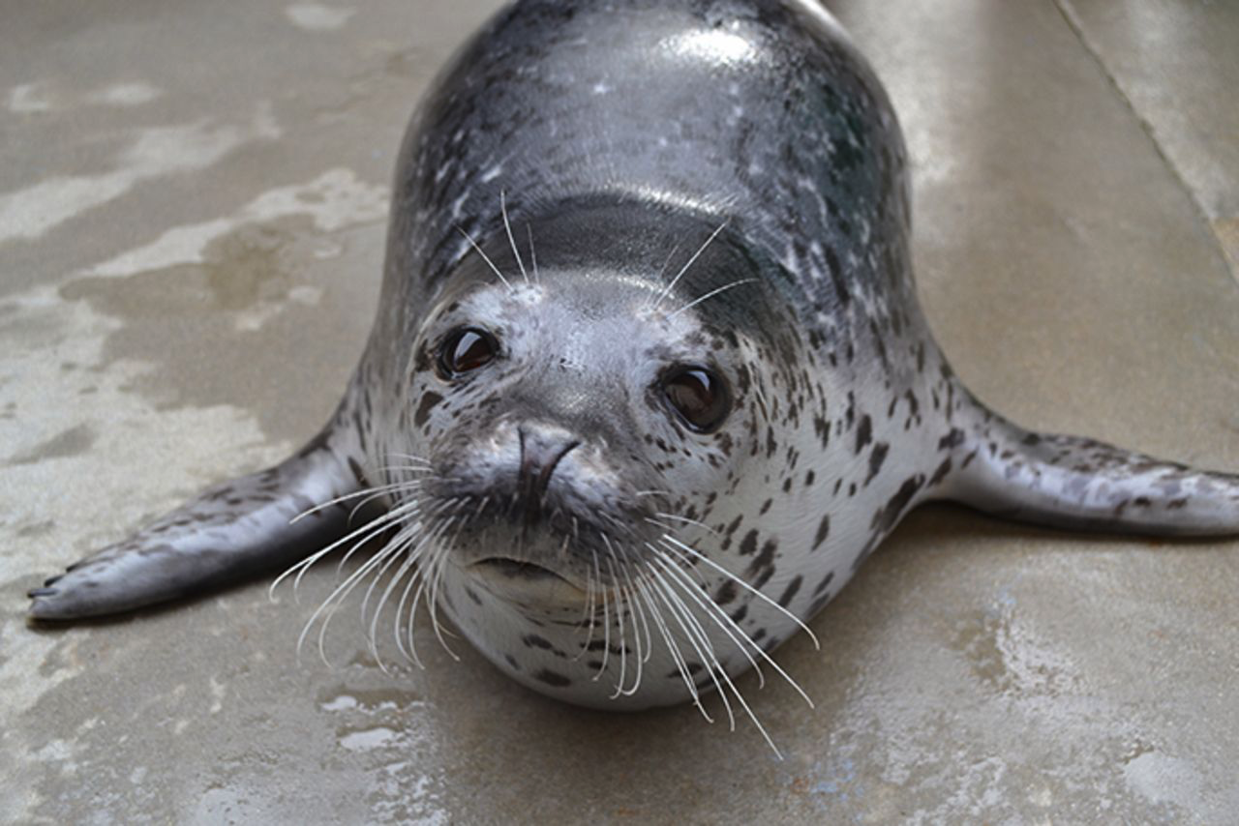
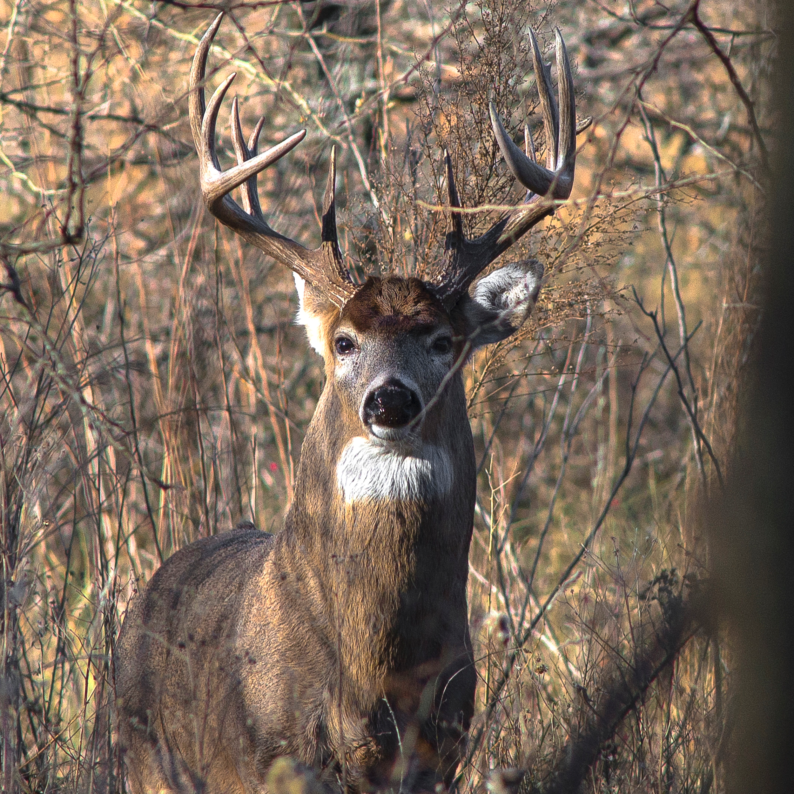
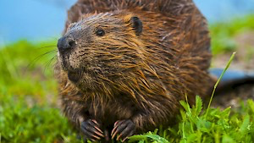
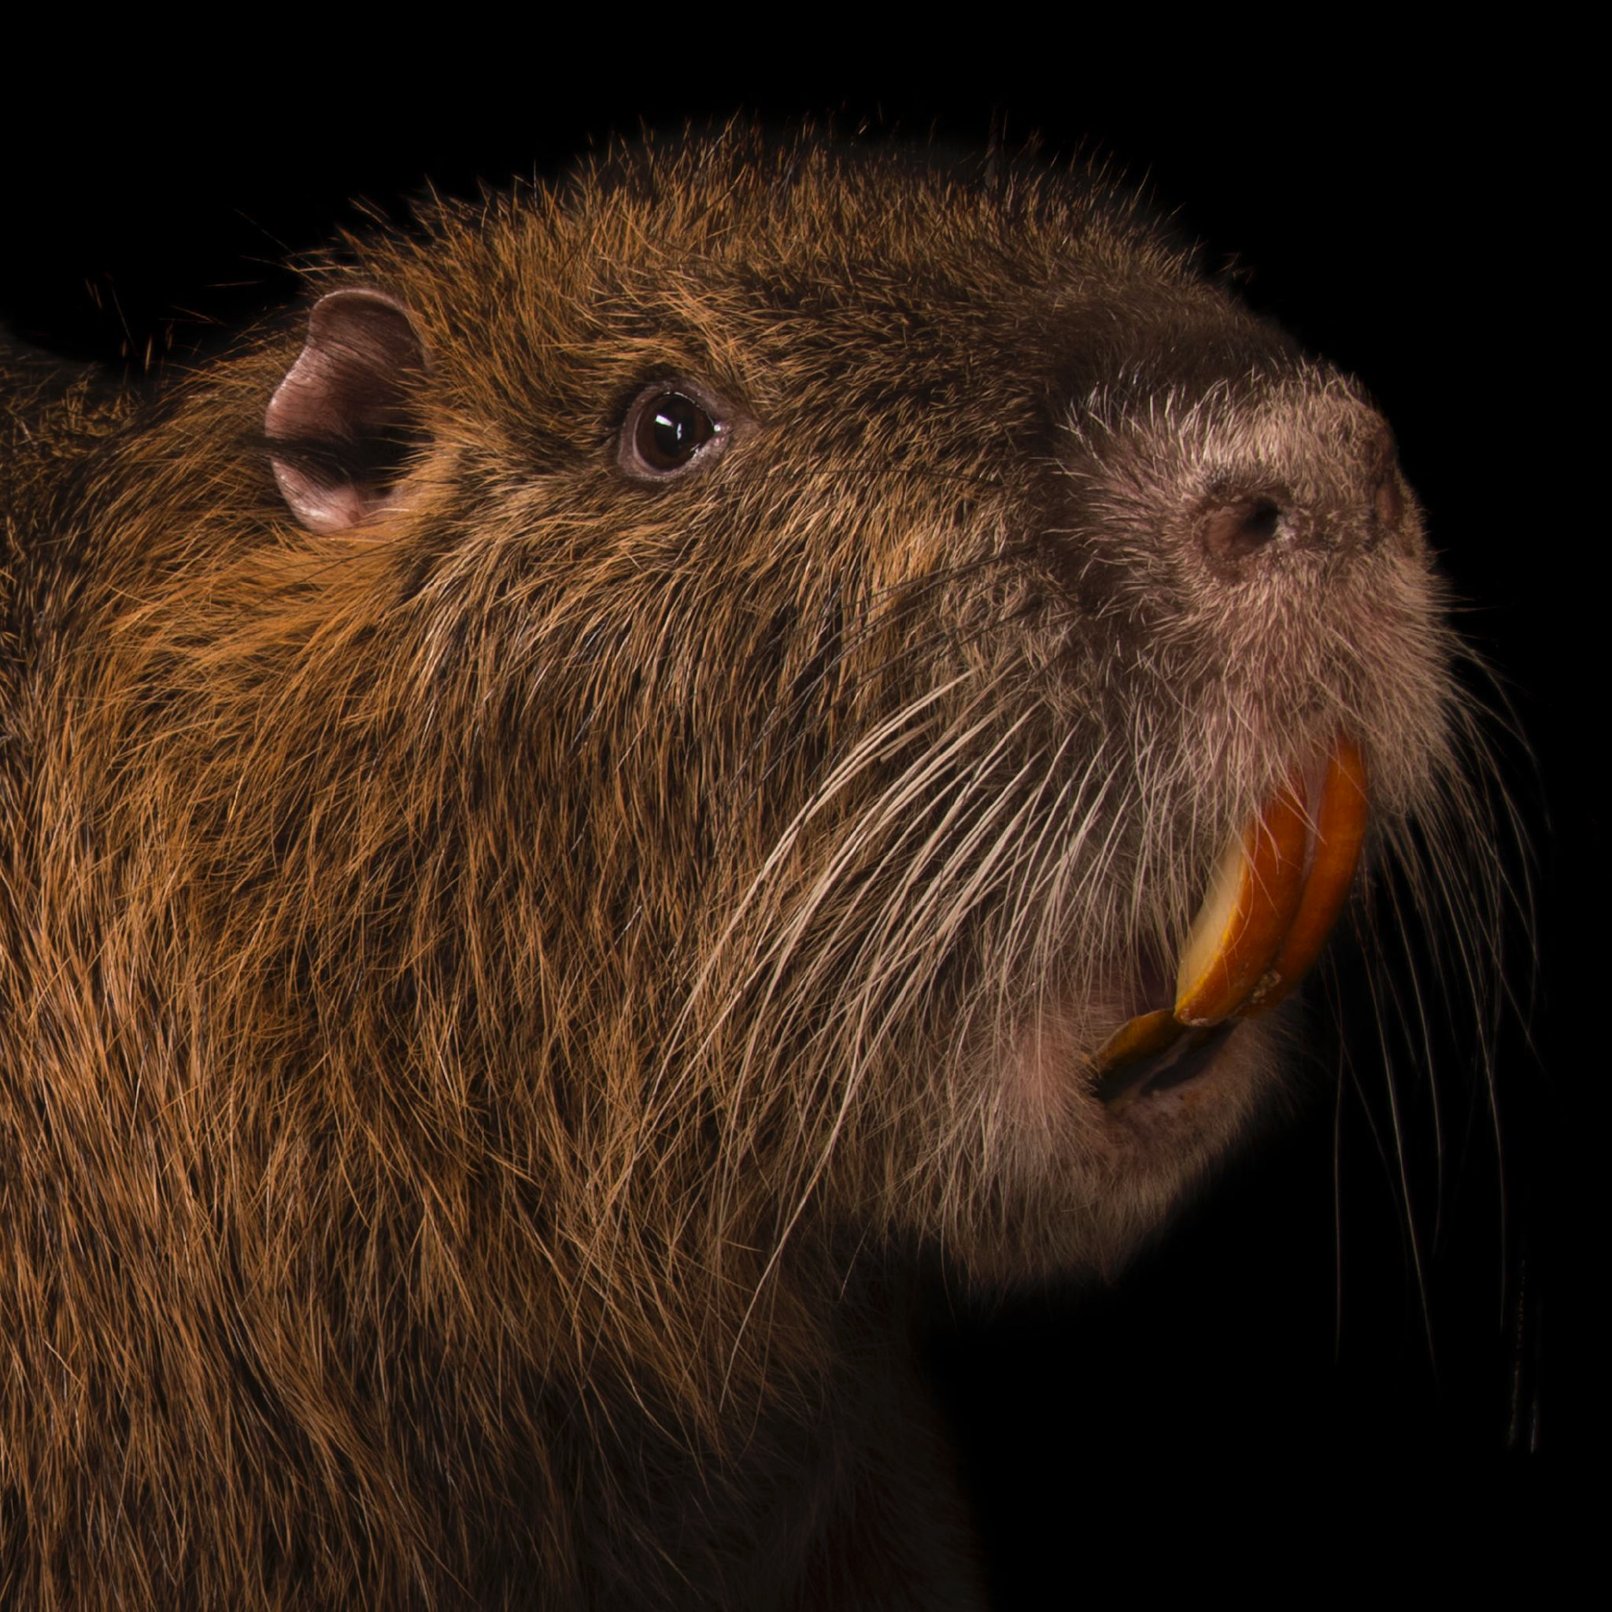
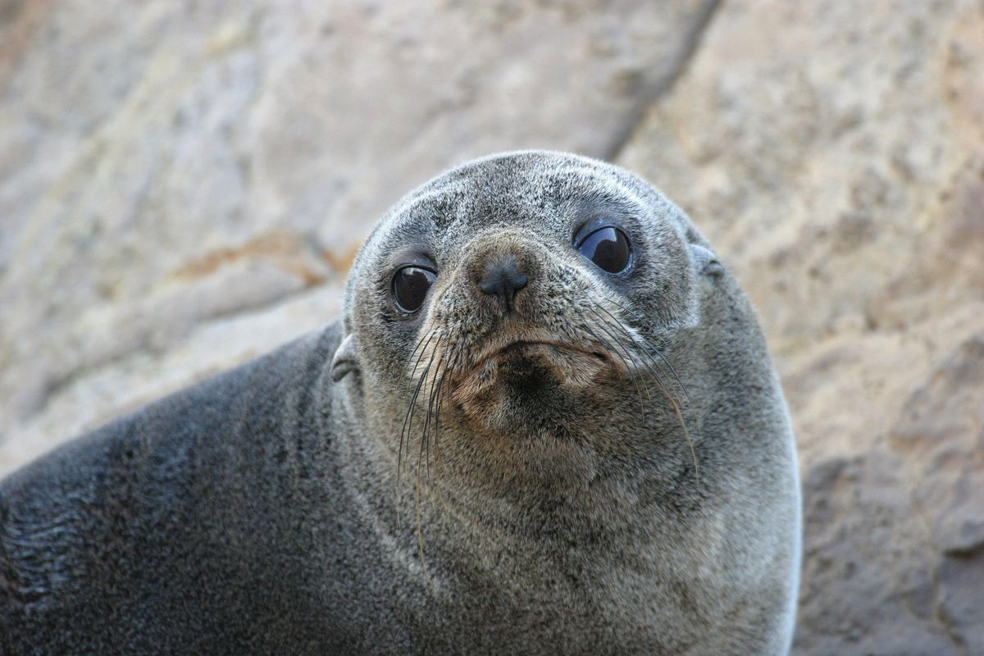
Multiclass Misclassification Makes Sense
Multiclass
75% Accuracy for first choice
94% Accuracy for top 3
Most Common Misclassifications
Columbian Deer as Whitetail Deer (6.8% ID rate)
Mountain Beaver as Nutria (35% ID rate)
Seals as Sea Lions (43% ID rate)

Slide 10
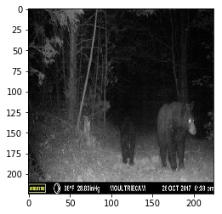
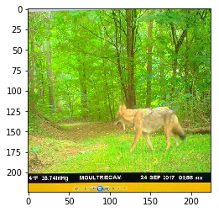
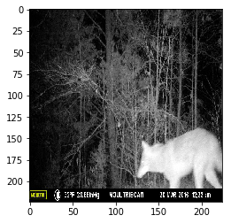
Real World Application
Top 3 guesses: ['black_bear', 'elk', 'gray_wolf']
Top 3 guesses: ['coyote', 'gray_fox', 'gray_wolf']
Top 3 guesses: ['gray_wolf', 'gray_fox', 'red_fox']

Slide 11
Future Improvements
Retrain models using more game camera photos at night.
Improve differentiation rates between similar species.
Refine geolocation data to update maps in real time.
Build webpage for citizens to upload images.

Slide 12
Thank you.

